Slide 1
Frontend #2 14.2.2017

Slide 2
Today’s agenda (1/2)
Time | Activity
8.30 | Welcome and overview
8.40 | Exercise from lecture 3 + learnings Semantic HTML
9.15 | Break
9.30 | Responsive Web Design
9.45 | Exercise 1
10.30 | Break

Slide 3
Today’s agenda (2/2)
Time | Activity
10.45 | Exercise 2
11.30 | Lunch
12.00 | Exercise 3
13.45 | Lessons learned today and next lecture

Slide 4
Exercise from lecture 1

Slide 5
Present your solution to the person next to you
How far did you get? (demo and code review)
Where were you challenged?
What may be unclear to you (HTML and CSS)?
Take notes and be ready to present the three
most important findings for me at the table.
Exercise from lecture 1 (10 mins)

Slide 6
Layouts in CSS

Slide 7
Layouts in Java and C#
Layout in CSS
Different layouts
Grid layout
Stack layout
Dock layout
…
Until FlexBox none
Layouts in CSS

Slide 8
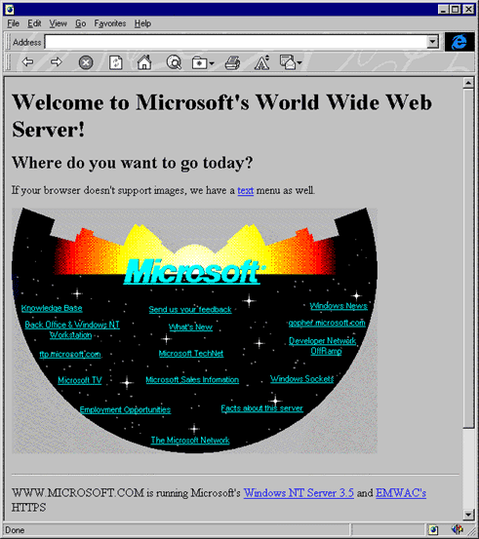
Early layouts
Tables
Hidden images
Microsoft first website
CSS Layouts

Slide 9
Float
The float property is widely used to create layouts.
In effect creating something resembling a wrap layout
nav {
float: left;
}
.group:after {
content: "";
display: table;
clear: both;
}
Clearfix hack
Removing float using the clear property
div {
max-width: 600px;
margin: 0px auto;
}
Center content
Center content can be tricky
Layouts - Floats
Notes:
Using auto margin within a div will center content

Slide 10

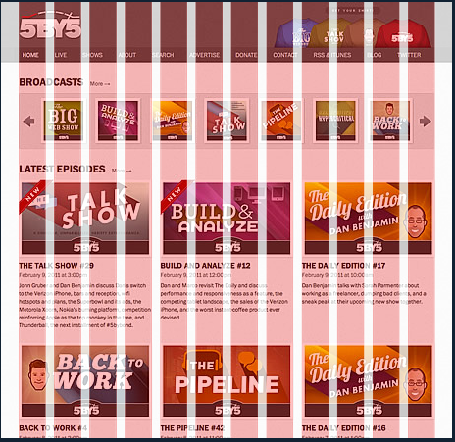
Example
http://960.gs/
Grid Layouts

Slide 11
Lots of hacks to achieve something that should be simple.
Fortunate for us, flexbox is well implemented, so we should start using flexbox
div {
display: flex;
}
FlexBox

Slide 12
Semantic HTML

Slide 13


All five levels of “Journey into Mobile”
Semantic HTML (all videos)
CSS Animation with Transition and Transform (ch. 1)
Preparation

Slide 14
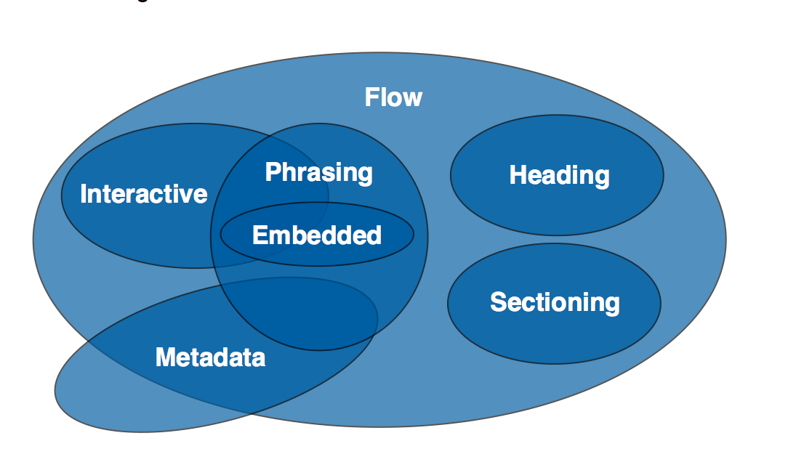
Visualisation of content categories
https://www.w3.org/TR/html5/dom.html#content-models

Slide 15
How does semantic HTML differ from non-semantic?
Who benefits from semantic HTML?
What is an HTML outline?
What are sectioning and grouping elements?
What is the purpose of heading elements?
What is Semantic HTML and why?
(5 questions)
Notes:
Semantic HTML is descriptive of the contents of the sections/tags
Benefit: Search engines, screen readers, programmers who need to look at your code

Slide 16

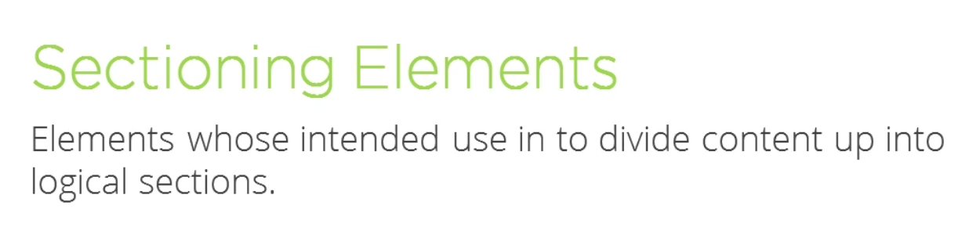
<main>
<nav>
<footer>
Contact information - not postal address
<article>
<aside>
<address>
<section>
<header>
Sectioning
https://developer.mozilla.org/en-US/docs/Web/Guide/HTML/Sections_and_Outlines_of_an_HTML5_document

Slide 17

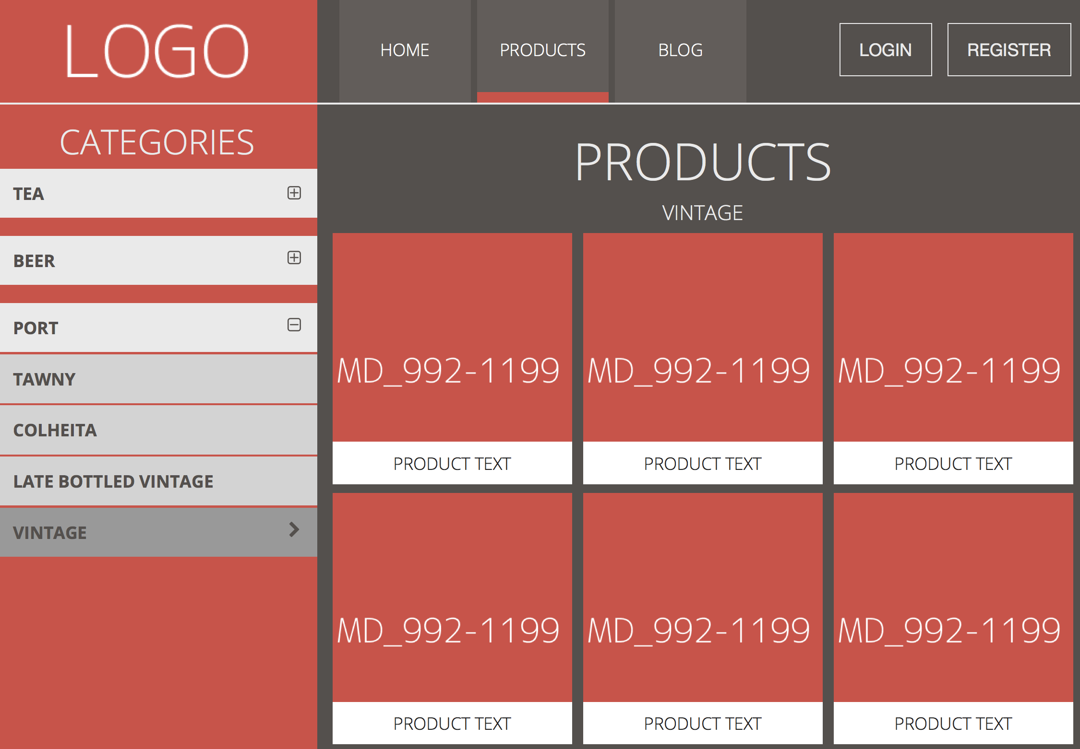
Which elements should be on first level?

Slide 18
<header>
<aside>
<main>
Which elements should be on first level?

Slide 19

Background image (set in CSS)
<nav>
Header elements

Slide 20
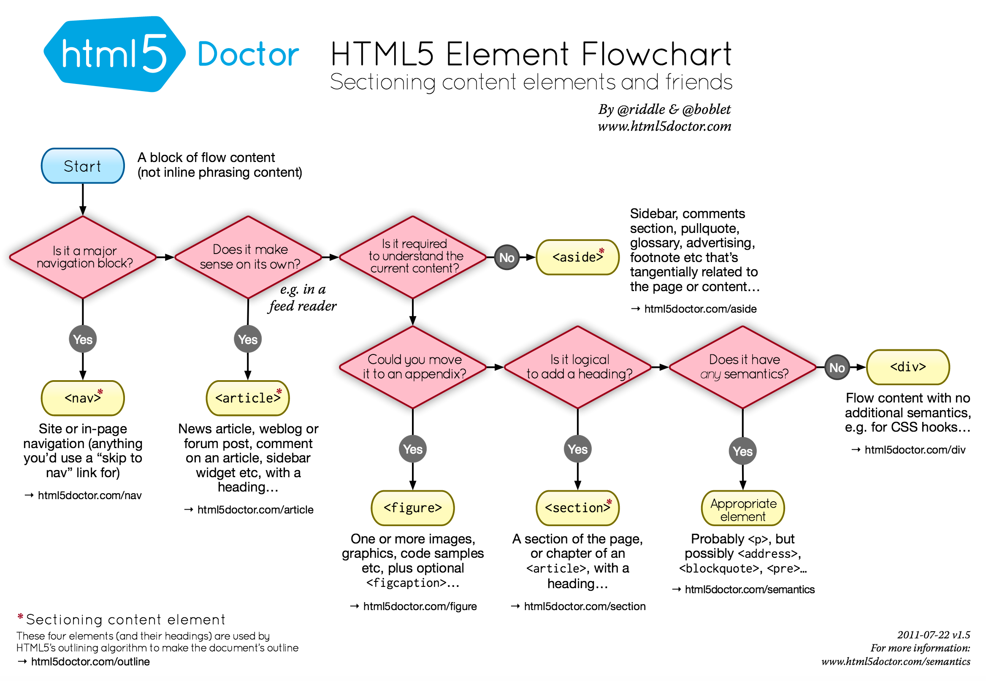

Slide 21
Responsive Web Design

Slide 22
Understand and use the four elements of RWD
Media Queries (@media rules)
Fluid Grid (px -> %)
Flexible Images (max-width: 100%; height: auto)
Viewport meta tag
Hiding and showing DOM elements
Learning objectives
Notes:
Media queries are used to target specific media rules such as screen size
Fluid grids: Using relative measures such as % or ems instead of fixed pixels
Using flexible images allows your images to scale down with your viewport. Remember to account for high density screens (image@2x.png)

Slide 23
Fluid Grid (percentages instead of pixels)
Flexible Images (max-width: 100%; height: auto)
Media Queries (@media)
Viewport meta tag
Central elements of RWD

Slide 24
Design mobile first
Mobile
CSS selectors as usual
Tablet
@media and (min-width: 600px) { … }
Desktop
@media and (min-width: 1024px) { … }
Mobile First

Slide 25

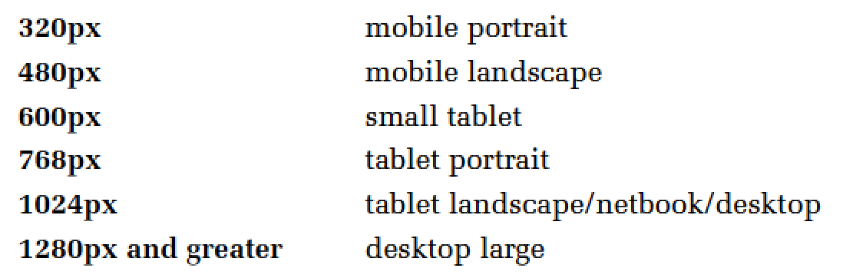
Screen resolutions
Screen resolutions (Jumpstart, p. 96)

Slide 26

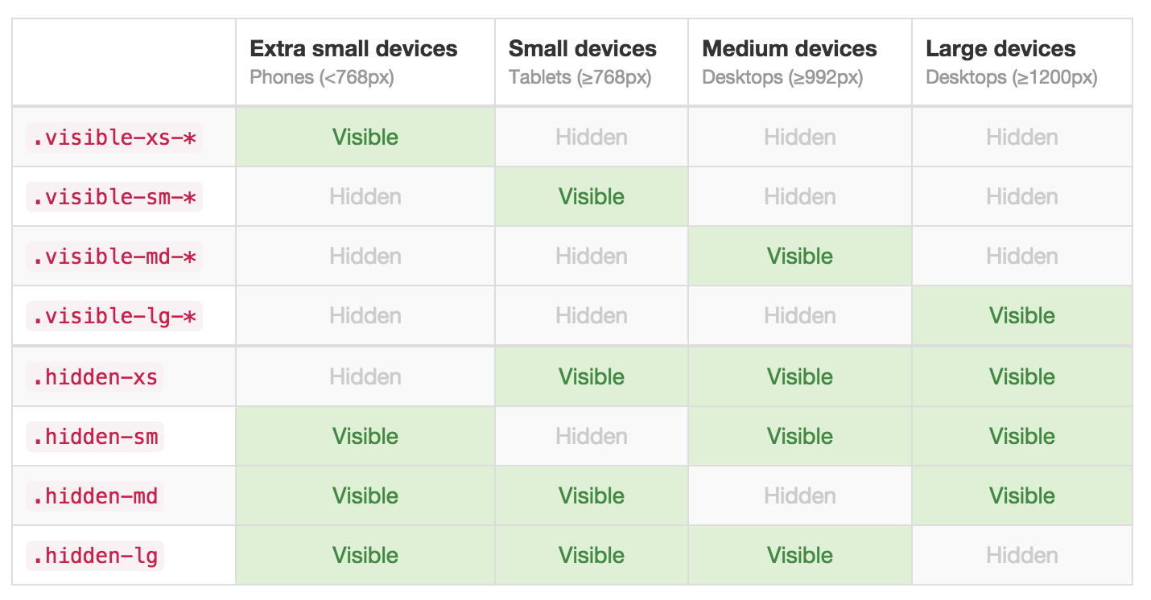
Screen resolutions (getbootstrap.com)

Slide 27
Viewport
vh - 1/100 viewport height
vw - 1/100 viewport width
vmin - 1/100 smallest side of viewport
vmax - 1/100 largest side of viewport
1 vmax = 1vh in portrait mode
1 vmax = 1vw in landscape mode
Viewport units

Slide 28
Is there anything you need to know
before you can create a responsive website?
Questions to RWD and Mobile First

Slide 29
Exercise Responsive Web Design

Slide 30
Fluid Grid, Flexible Images, Media Queries, Viewport meta
Good practice for CSS file order
Font Awesome, dummyimage, lorempixel
<picture> element
overflow: auto - 100% height of html, body
Topics I might talk about during the exercise
Notes:
CSS file order:
Tags
Classes
Media queries

Slide 31
General elements (body, h1, aside…)
Generic UI elements (.pull-right, .hidden-sm…)
Overwrites of 3rd party CSS (i.e. Font Awesome)
Follow the structure of the markup (header, aside, main, footer…)
Media queries
Good practice for CSS order
http://code.tutsplus.com/tutorials/30-css-best-practices-for-beginners--net-6741

Slide 32

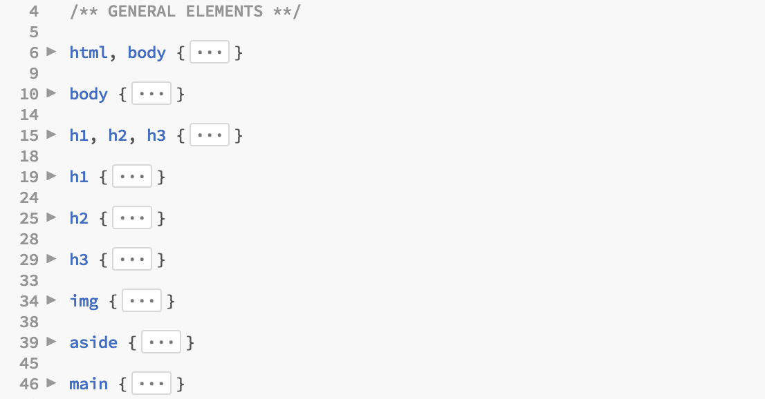
Example of structure

Slide 33

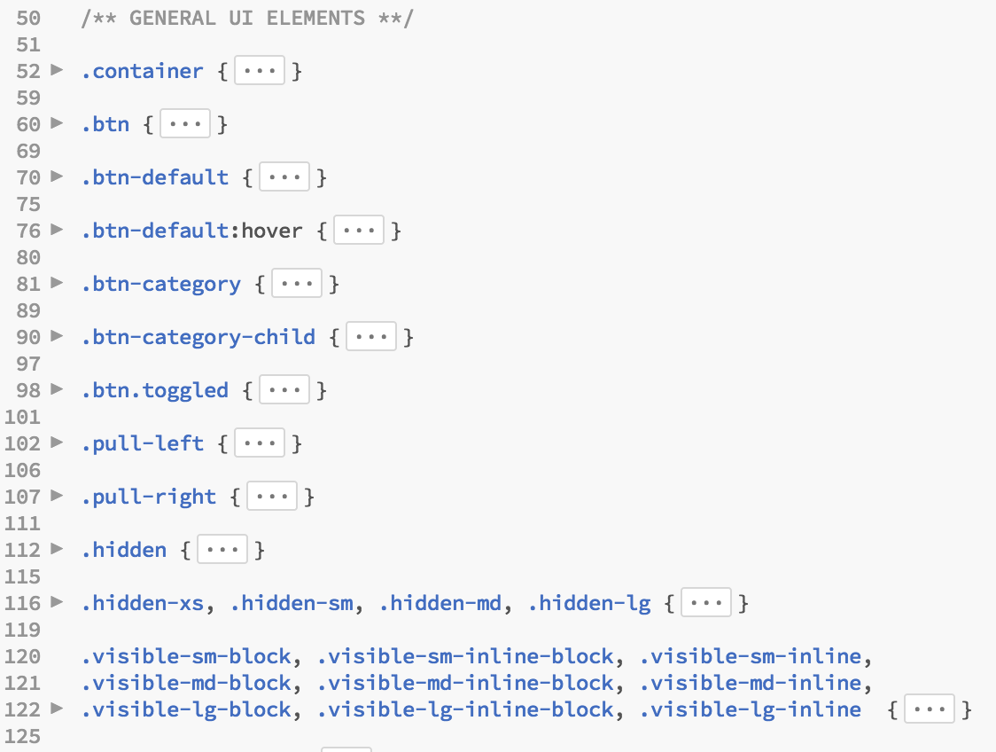
Example of structure

Slide 34

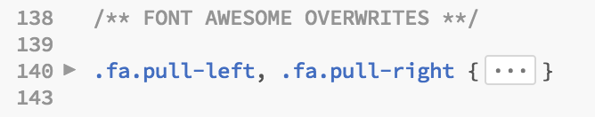
Example of structure

Slide 35

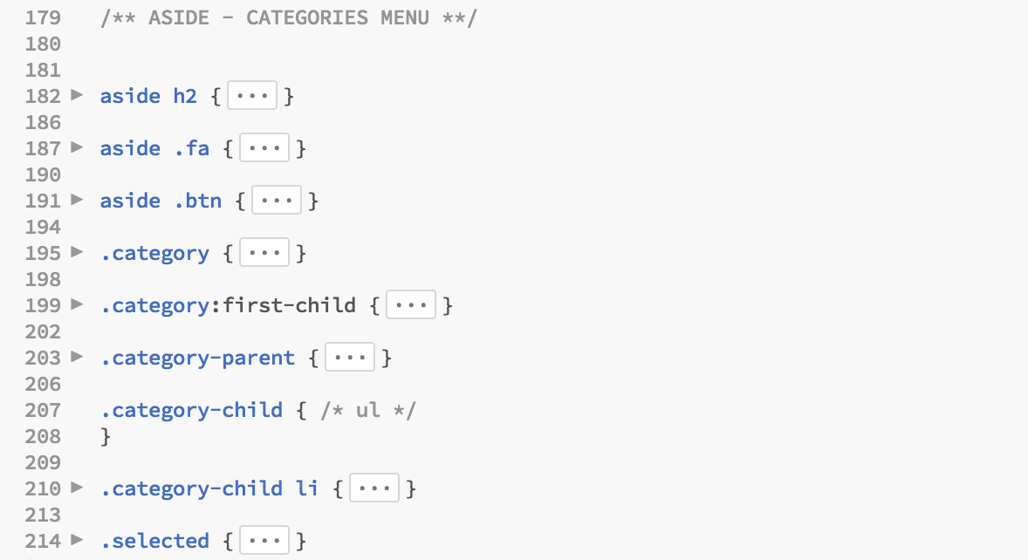
Example of structure

Slide 36

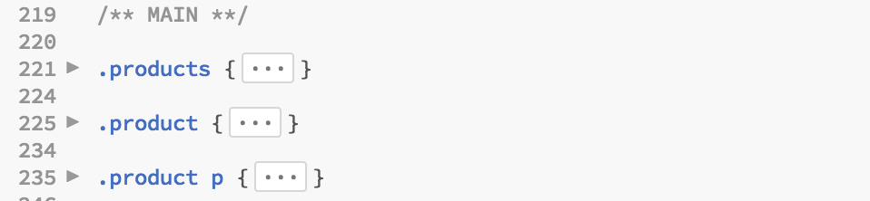
Example of structure

Slide 37

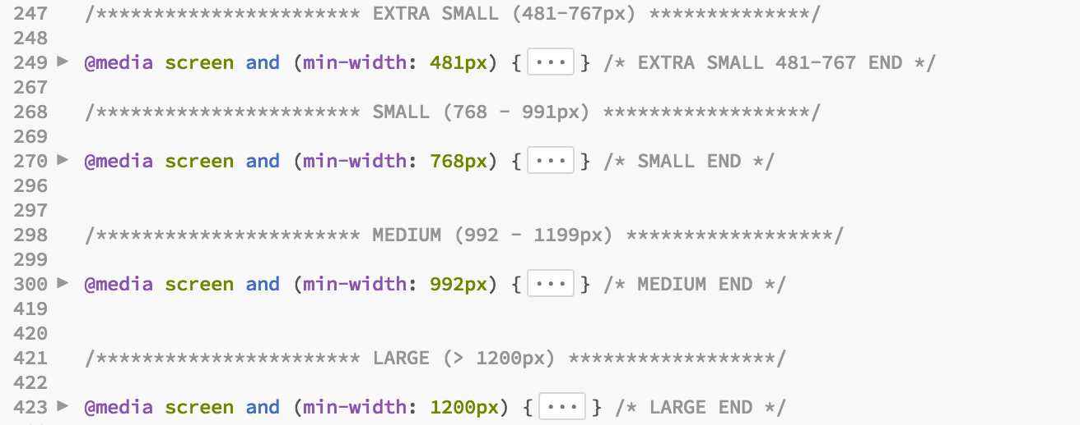
Example of structure

Slide 38
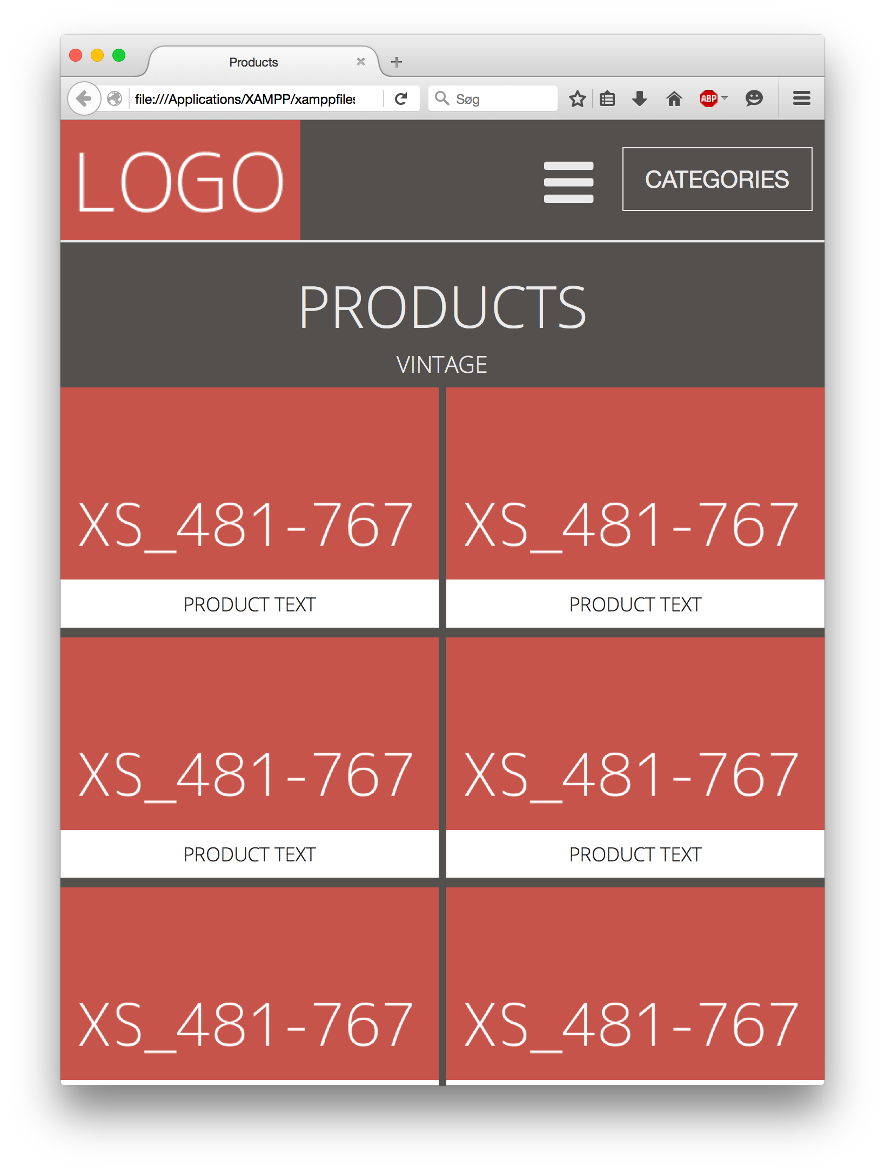
Exercise on Fronter
in today’s folder.
(with hints)
Mobile First - Products page - exercise

Slide 39
Lessons Learned

Slide 40
Understand and use the four elements of RWD
Media Queries (@media rules)
Fluid Grid (px -> %)
Flexible Images (max-width: 100%; height: auto)
Viewport meta tag
Hiding and showing DOM elements
Learning objectives

Slide 41
Sass – CSS Preprocessor
Scalable and Modular Architecture for CSS
Code School: Assembling Sass
Smacss.com
PluralSight: Smacss talk
Preparation (next Tuesday – CSS Preprocessors)

